Slide 1
Data & Software Support – Why you probably don’t know us!
Julia Steinecker
Director Data & Software Support EMEA

Slide 2
Your MapInfo Software Support Team.
Between us, we have over 40 years MapInfo experience…

Slide 3
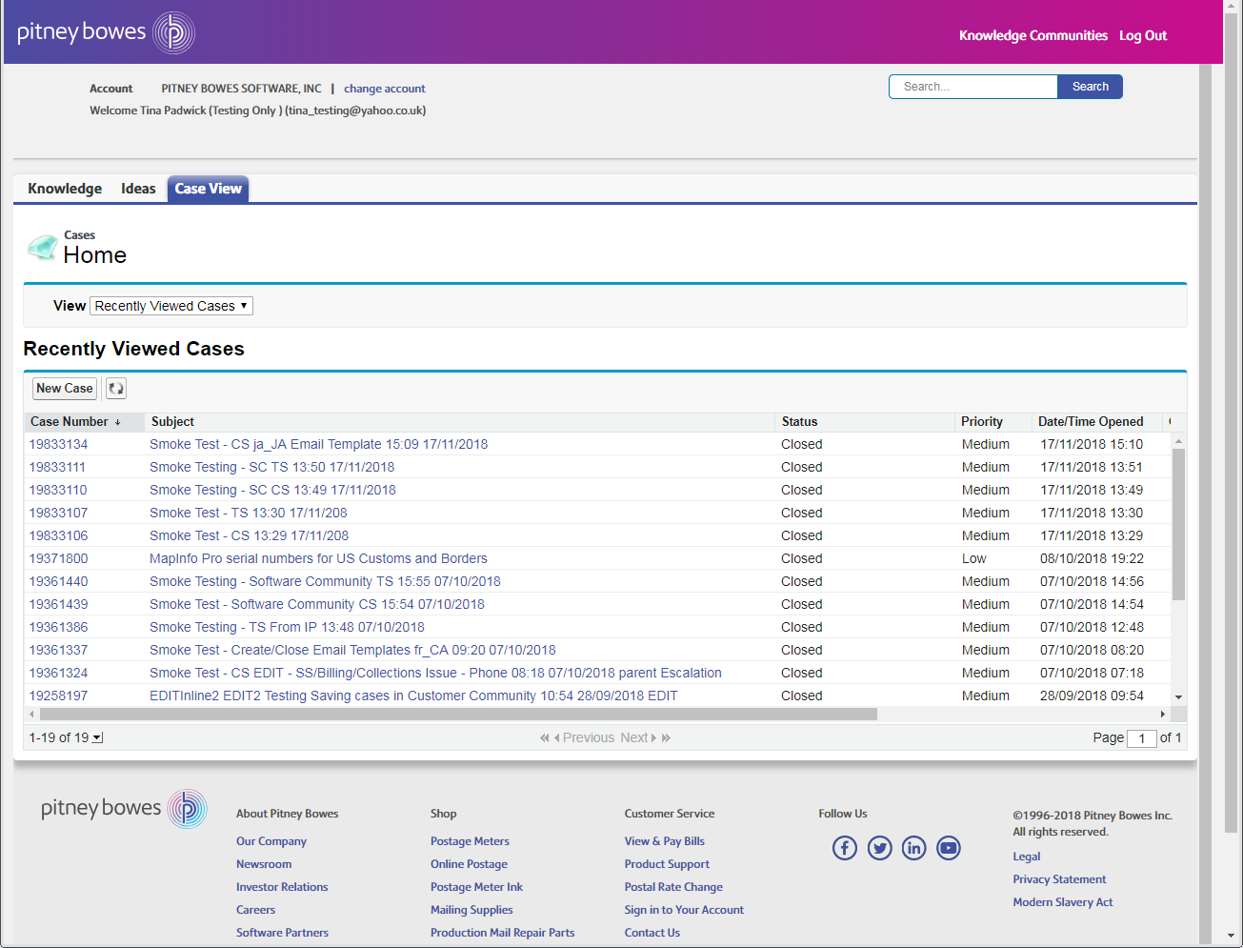
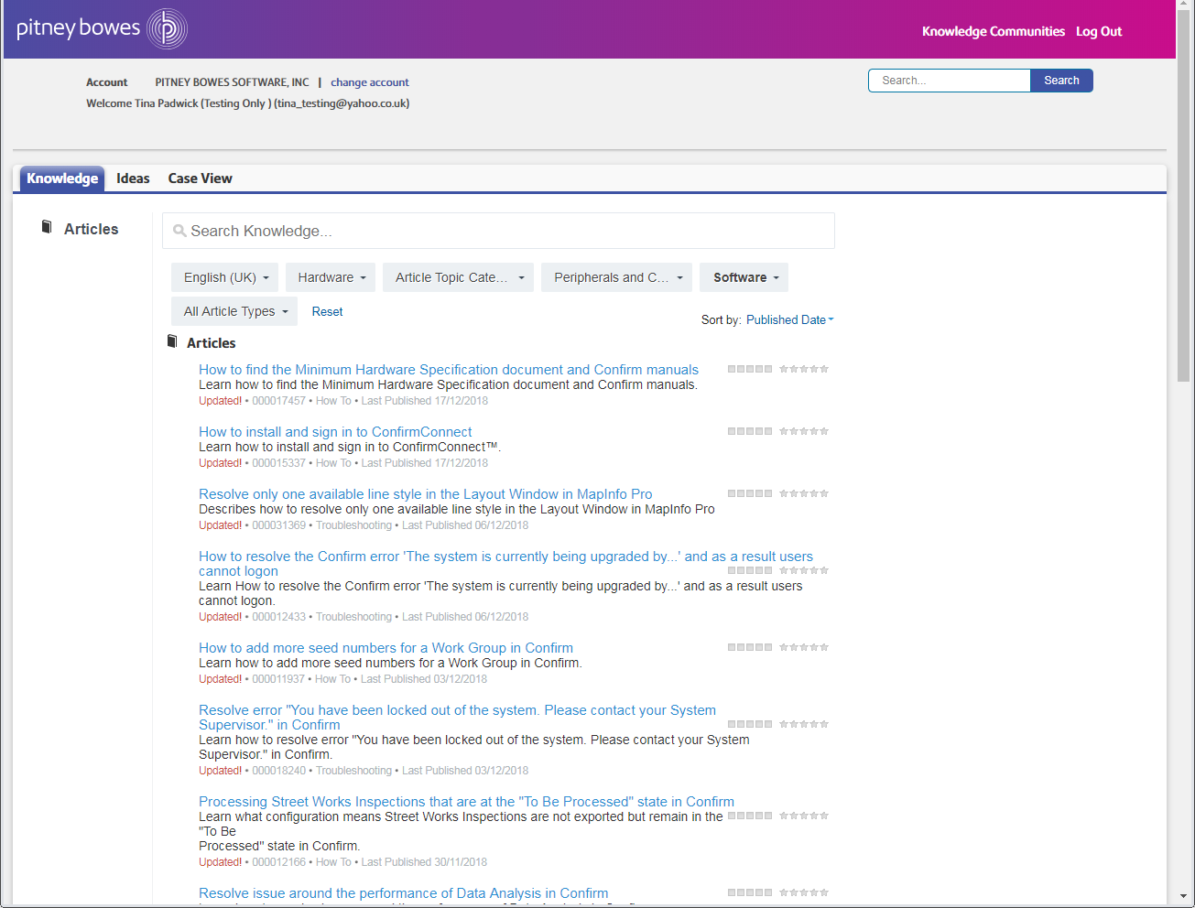
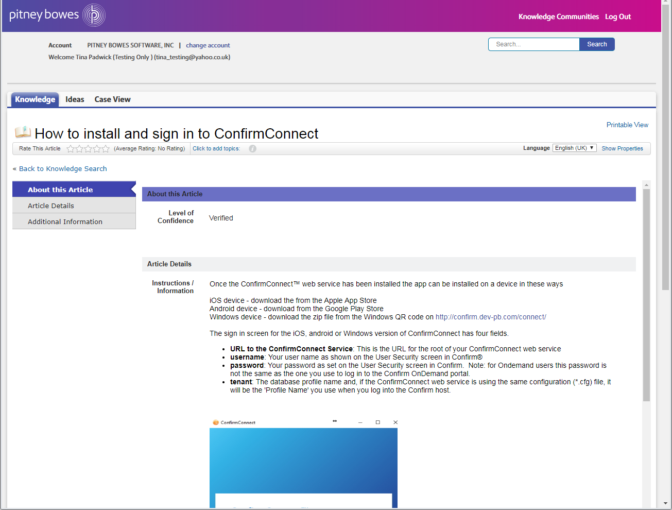
Knowledge Articles.
Internet search engines
Knowledge Communities
Client Portal

Slide 4
Knowledge Articles.
14,000+ knowledge articles globally
QA initiative from June 2017 - ongoing
KB Articles searchable on any internet search engine
Knowledge videos now integrated

Slide 5
Knowledge Videos.
Convert existing knowledge articles into videos.
Knowledge articles are selected based on:
1) The number of public views
2) Number of cases the articles are attached to
Published on our PB YouTube Channels.

Slide 6
MapInfo Software Support – We’re happy to help.
Software Support: +44800 840 0001 (UK) software.support@pb.com
clientservice-PBS@pb.com
Support Manager: Justin Tate
+44 7872 156436 justin.tate@pb.com

