Slide 1
Spectrum Enterprise Connectors Himanshu Verma CIM Product Management
Jan 3, 2019

Slide 2
Spectrum Enterprise Connectors
Data Quality
Data Integration
Native Add-ons for popular CRM, ERP, eCommerce & Marketing Automation systems; provides seamless integration
Integrate Governance and Data Quality processes at Front-end
Remediate issues at scale in Batch mode
Standardize customer information in Real-time
Validate & enrich address for 250+ countries
Spatial enrichment
Support for standard entities (Customer, Contact, Lead etc.) & transactions (Order, Quote, Invoice etc.)
Integrated DQ reports to assess quality of data
Spectrum On-premise & On-demand connectivity
API-based connectivity to popular CRM, ERP, eCommerce & Marketing Automation systems
Integrate directly with database layer or via SOAP/REST based services
Promotes ETL (Extract-Transform-Load) scenarios
Supports both real-time & bulk integration
Allows user to read, write and synchronize data within single or multiple systems
Support for standard entities (Customer, Contact etc.) & transactions (Order, Quote, Invoice etc.)
Available with Spectrum Metadata Insights with paid licenses for popular business systems
Spectrum On-premise connectivity

Slide 3
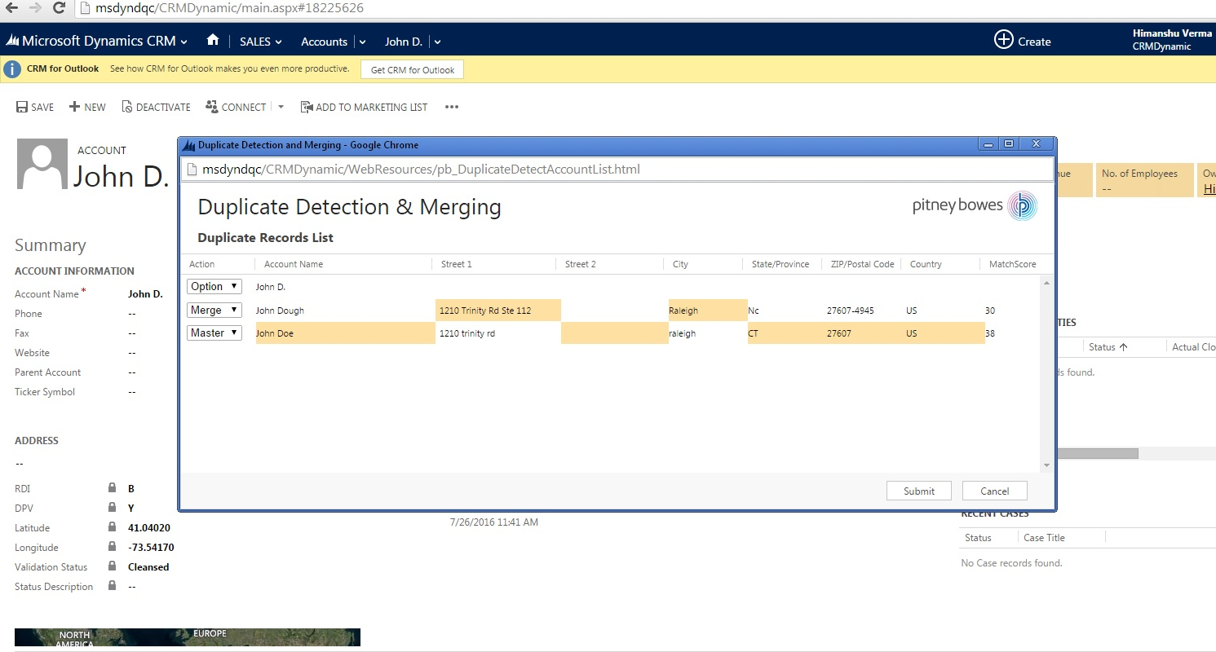
Spectrum Data Quality Connectors Common Use Cases
Sales Reps spending unnecessary time in a CRM trying to update records & reconcile poor data
Marketing campaigns not reaching the right audience at the right time, leading to poor conversion rates
Service Reps unable to serve customer due to the inability able to identify them correctly in the database

Slide 4
Spectrum Data Quality Connector for SAP (ECC, CRM & S/4HANA)

Slide 5
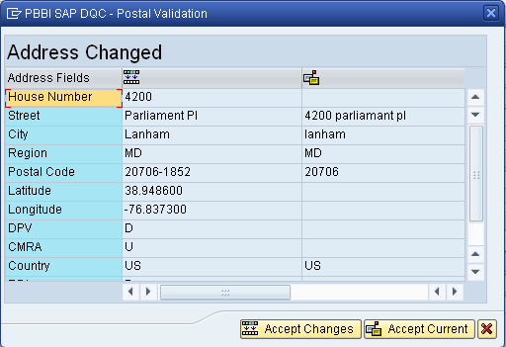
Spectrum Data Quality Connector for SAP Real-time Address Validation view
Street input
as given by user
Cleansed and validated Address after street validation
Standardized data is not necessarily accurate data. In the validation process, information is checked against known, up-to-date reference data for correctness. The sources used for this process may include regulatory bodies (e.g., United States Postal Service), third-party data providers or a company’s internal reference sources (e.g., accounting data). Postal validation ensures that the correct postal data is entered when addresses are maintained.

Slide 6
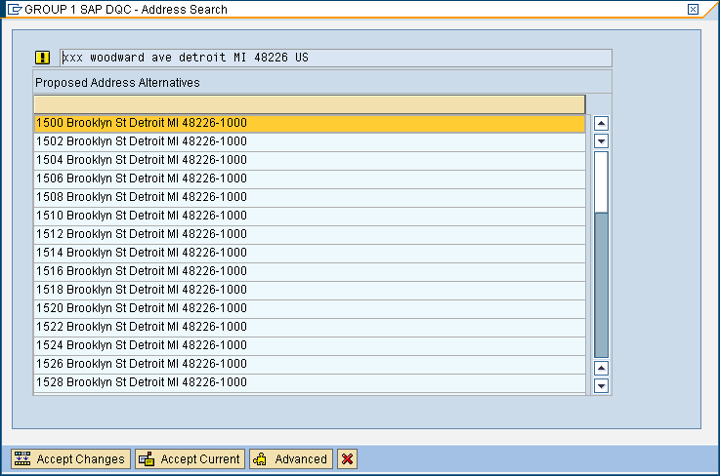
Spectrum Data Quality Connector for SAP Address Validation view in case of multiple candidates
One address can be highlighted and chosen

Slide 7
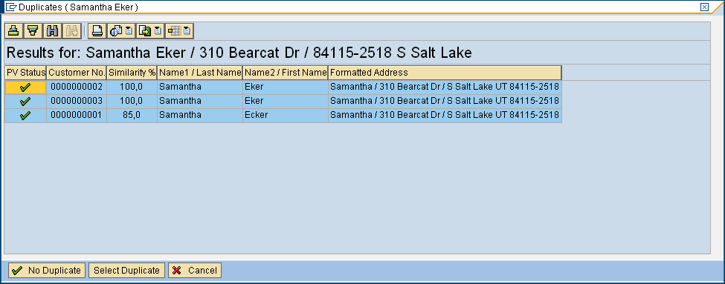
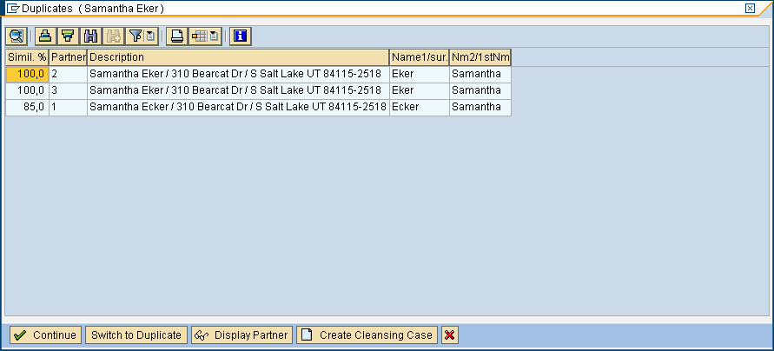
Spectrum Data Quality Connector for SAP Real-time Deduplication View
Duplicate matching identifies potential duplicate records or relationships between records, whether the data is name and address in nature or any other type of customer information. Spectrum Technology Platform allows you to specify a consistent set of business match rules using Boolean matching methods, scoring methods, thresholds, algorithms and weights to determine if a group of records contains duplicates.

Slide 8
Spectrum Data Quality Connector for NetSuite

Slide 9
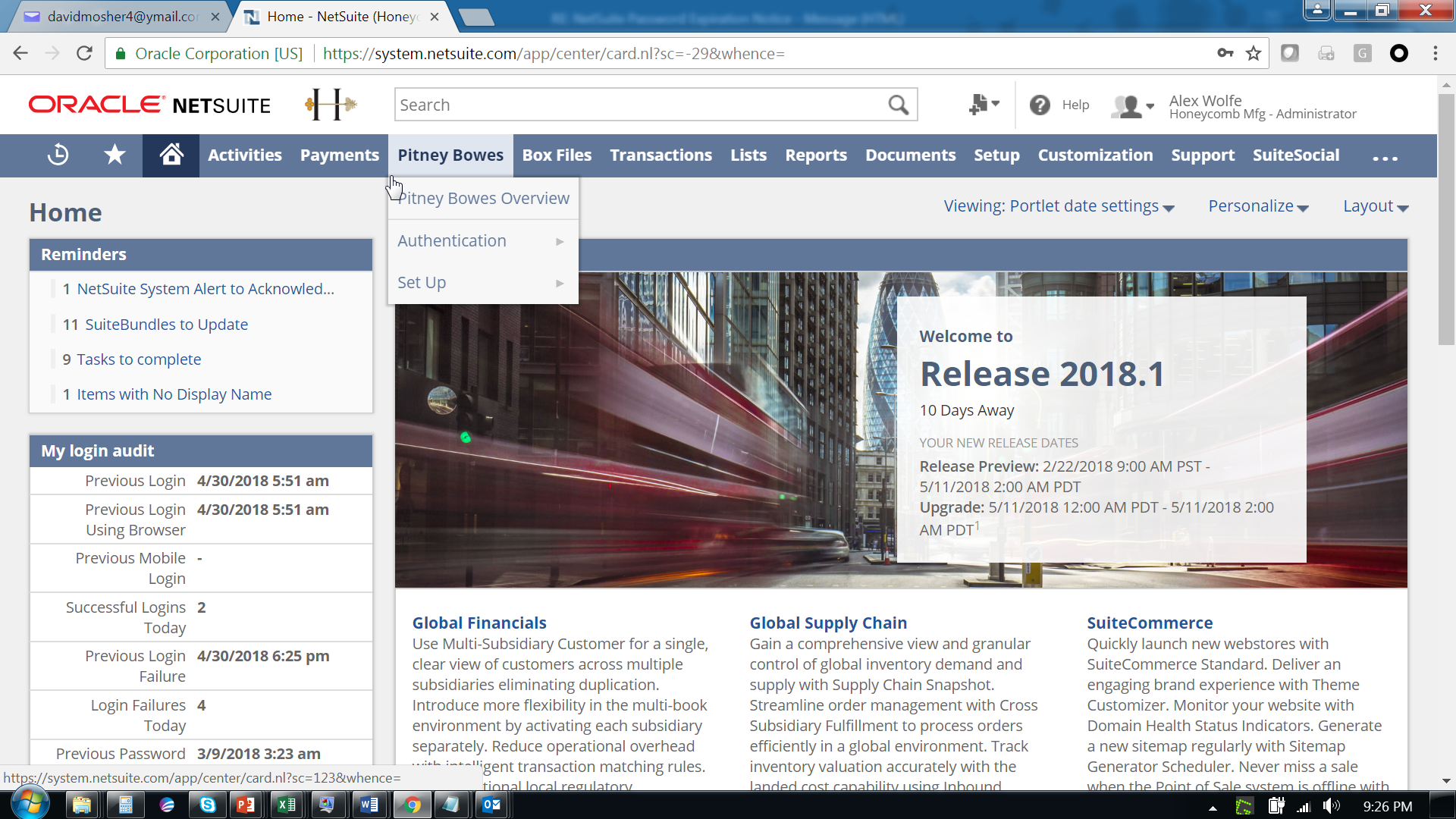
Spectrum Data Quality Connector for NetSuite

Slide 10
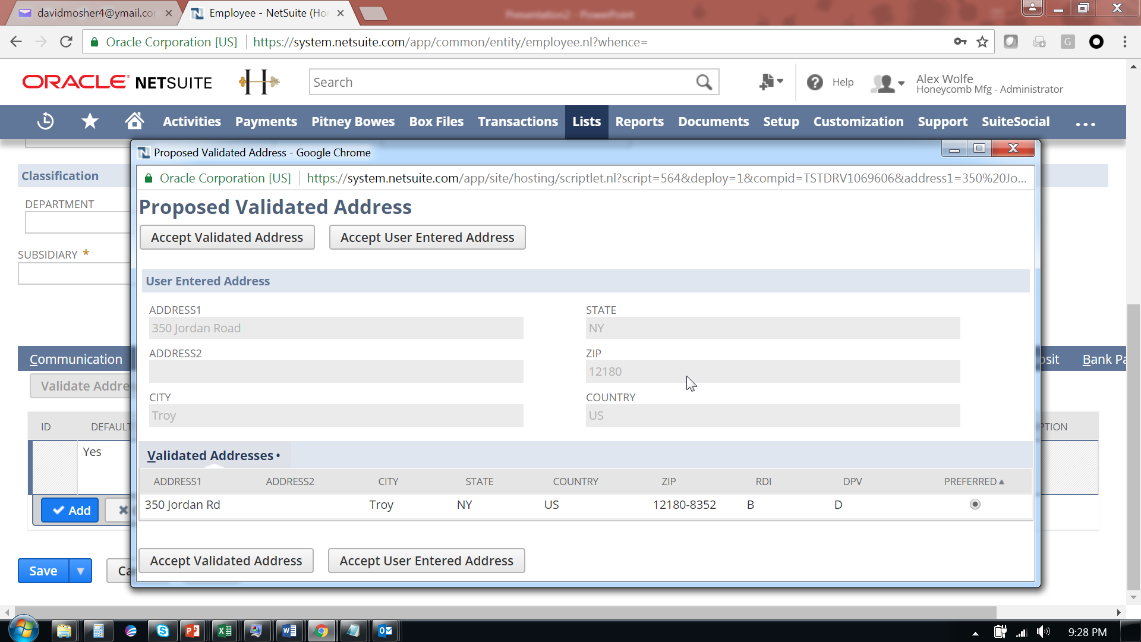
Spectrum Data Quality Connector for NetSuite Real-time Address Validation view

Slide 11
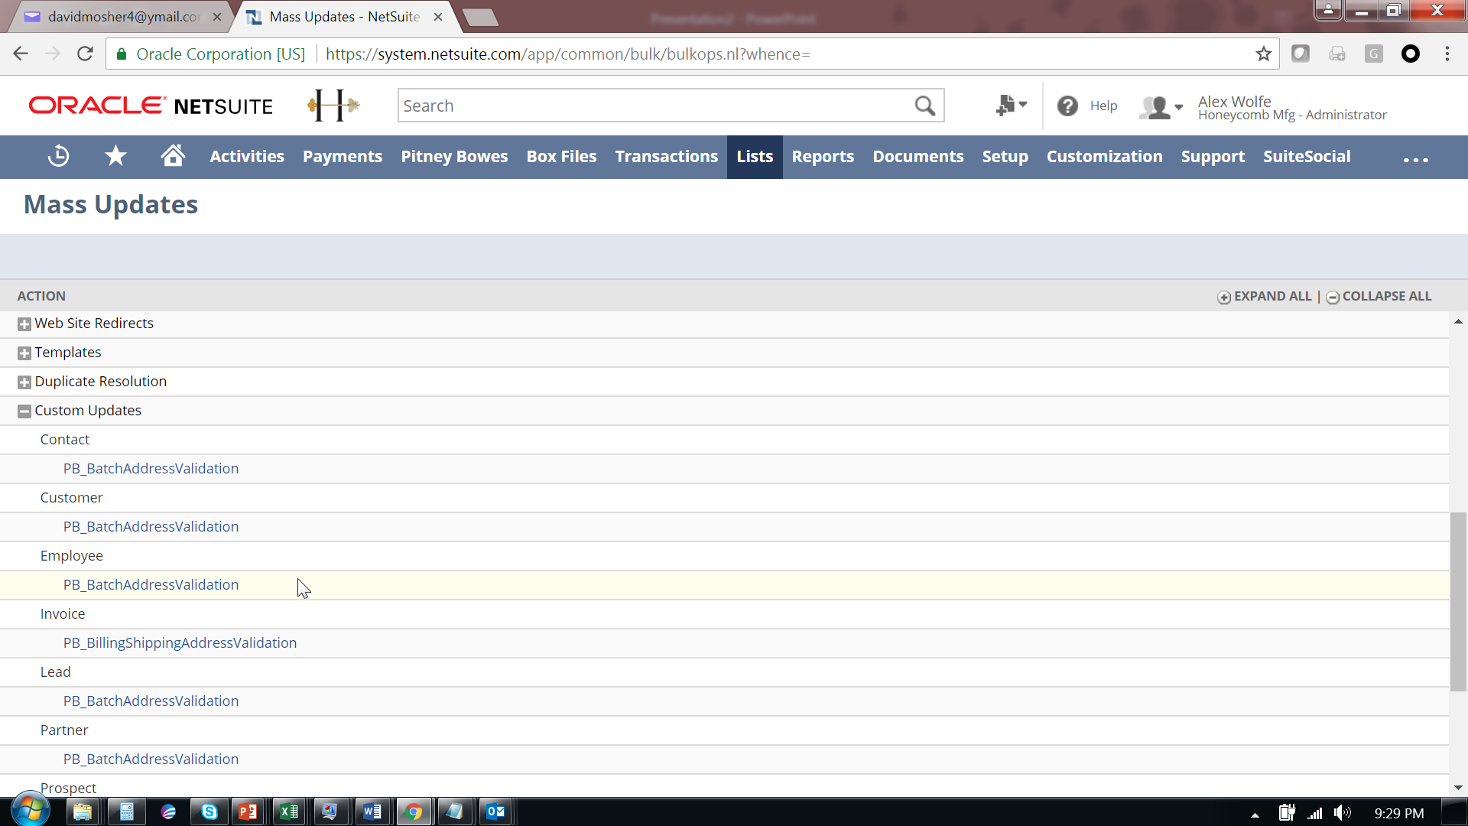
Spectrum Data Quality Connector for NetSuite Bulk Address Validation view

Slide 12
Spectrum Data Quality Connector for SugarCRM

Slide 13
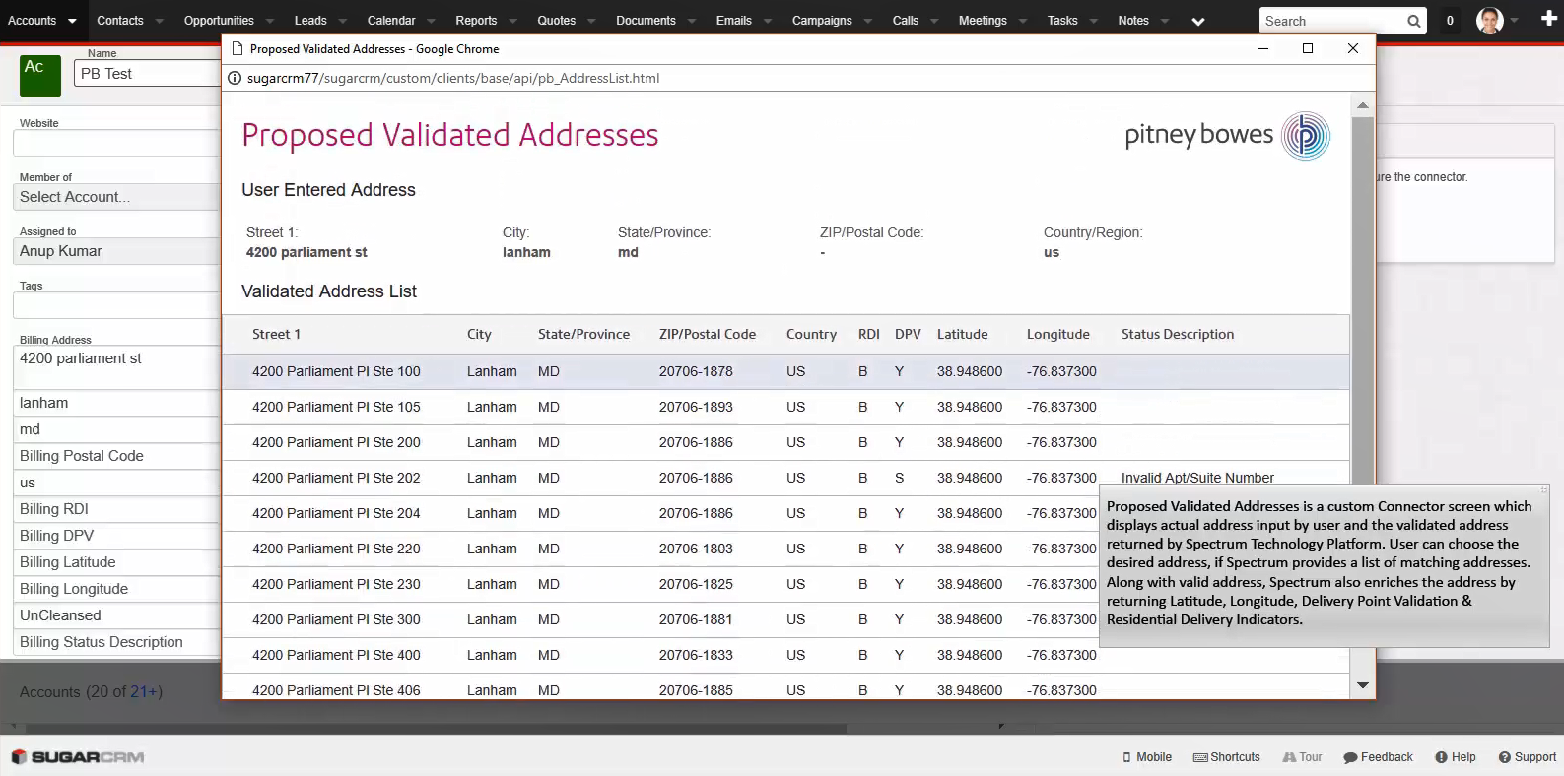
Spectrum Data Quality Connector for SugarCRM Real-time Address Validation view

Slide 14
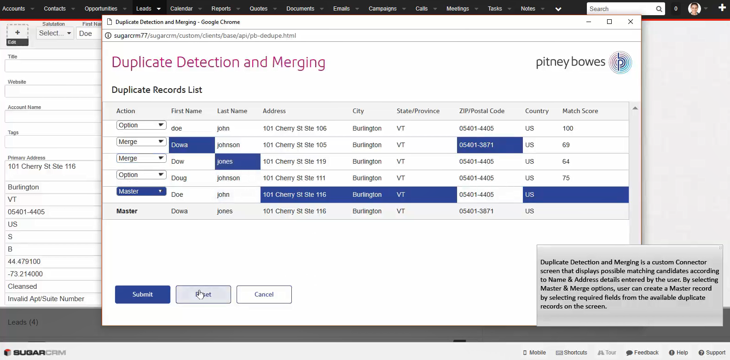
Spectrum Data Quality Connector for SugarCRM Real-time Deduplication & Merging View

Slide 15
Spectrum Data Quality Connector for SFDC Proof-of-concept

Slide 16
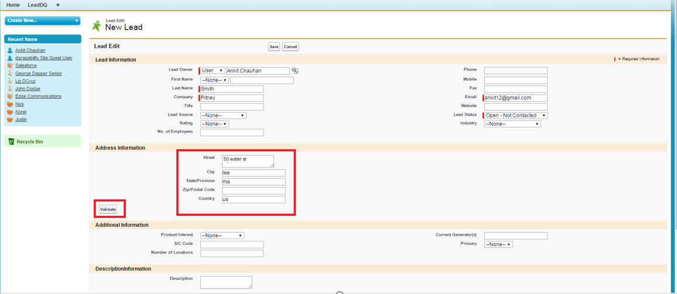
Spectrum Data Quality Connector for SFDC POC Real-time Address Validation view

Slide 17
Spectrum Data Quality Connector for SFDC POC Address Validation view in case of multiple candidates

Slide 18
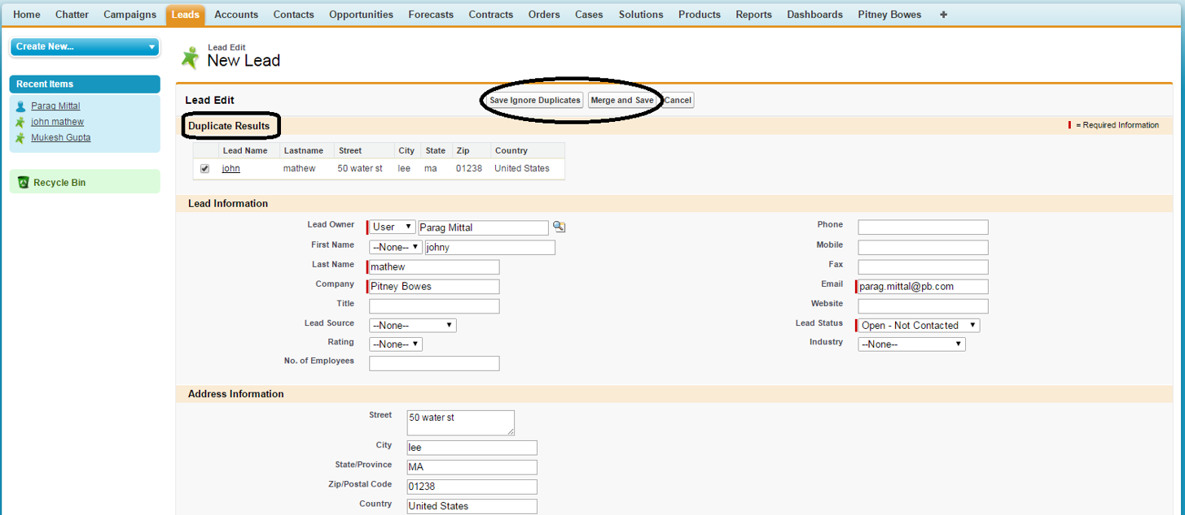
Spectrum Data Quality Connector for SFDC POC Real-time Deduplication View

Slide 19
Spectrum Data Integration Connectors Available via Metadata Insights

Slide 20
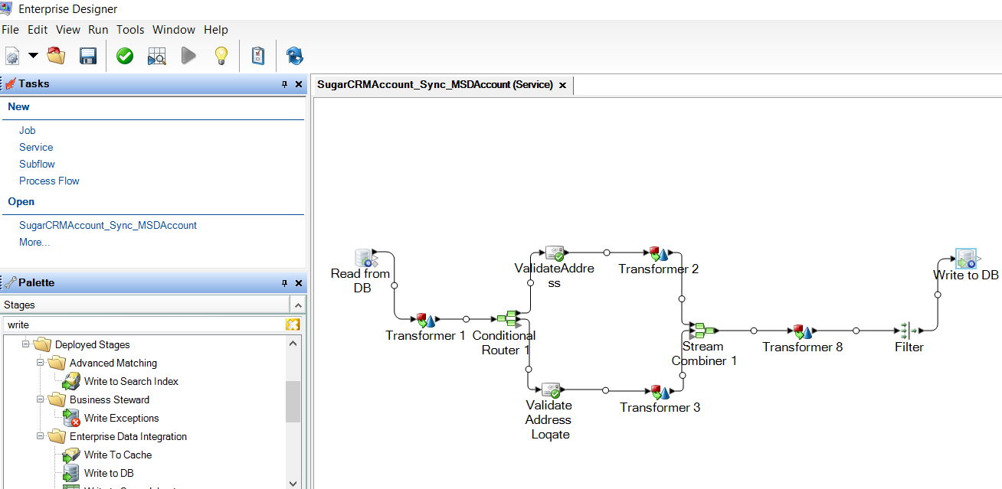
Spectrum Data Integration Connectors Common Use Cases
As part of Digital Transformation initiatives, organizations looking to consolidate & migrate data from an on-premise systems to SaaS based systems
Synchronize new Leads created in a Marketing Automation system with a CRM system, to enable real-time flow of current data between connected systems
Enable Single view of data in an enterprise landscape

Slide 21
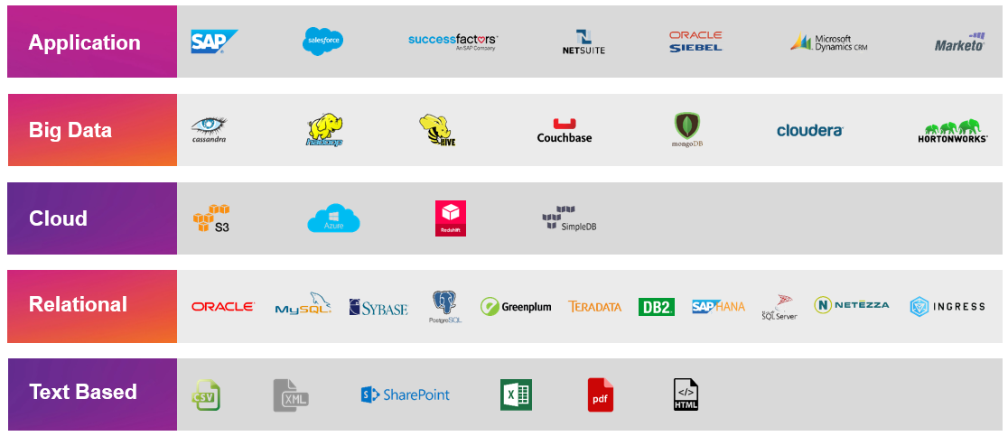
Spectrum Data Integration Connectors Supported Stack
Confidential/NDA

Slide 22
Leveraging Spectrum Data Federation to Integrate with external systems
Use Data Federation to operationalize siloed or use specific data.
JDBC / ODBC / SOAP / REST
Provide standardize access to common Analytic and BI tools.
Simplify and consolidate data for business users through logical models.
Create Ah-Hoc access that can be promoted to BW / ETL process as needed, or can virtually extend the warehouse.
Use Logical Models to isolate end users and other systems from underlying changes.
Logical Model
Physical Model
Spectrum Connectors

Slide 23
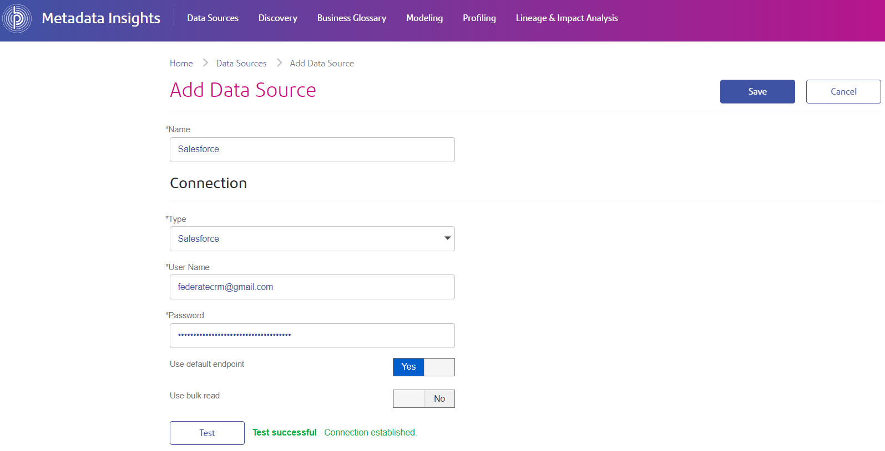
Spectrum Data Integration Connector for SFDC Test Connection View

Slide 24
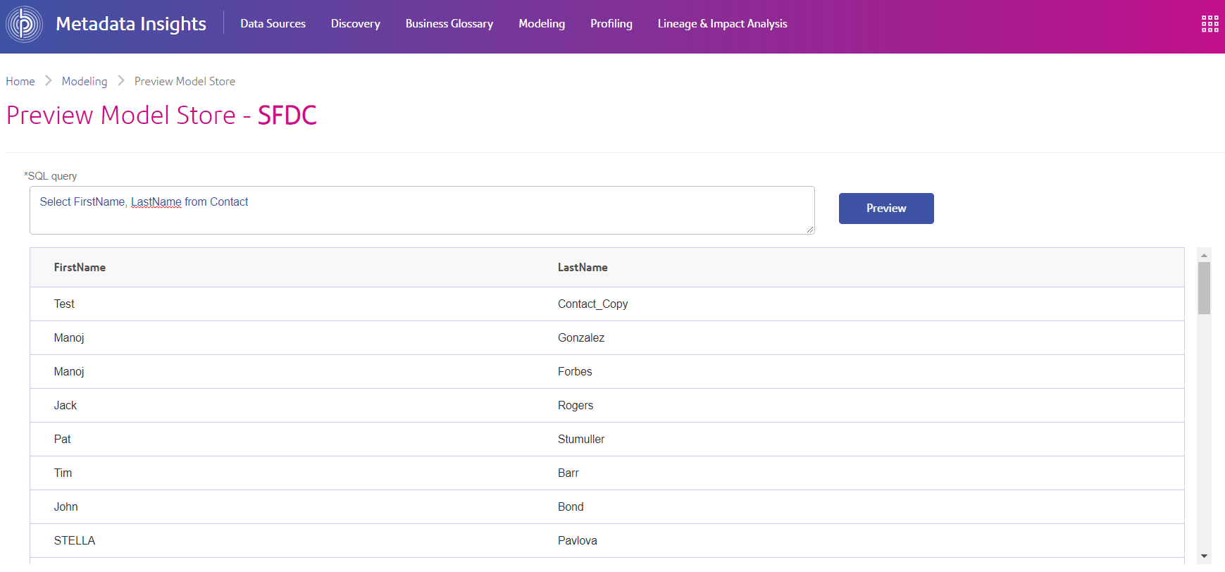
Spectrum Data Integration Connector for SFDC Model Store preview displaying queried Contact data from saved Connection

Slide 25
Spectrum Data Integration Use Case Demo Leads Synch between Marketo & MS Dynamics CRM

Slide 26
Thank You!

